Slide 1
Case Study: How do annual members and casual riders use Cyclistics bikes differently?
06 May 2023 ROHIT YADAV

Slide 2
Goal for our discussion
1
Overview of dataset of cycle service usage
The Dataset used for our analysis . Cleaning and manipulations of dataset done for analysis
2
Analysis findings
The pattern of usage of cycle share service by member and casual customers hourly , weekly , monthly so that further marketing strategy could be formulated for Growth.
3
Discuss major findings any potential area for further exploration
How the member and casual riders use the cyclistic bike differently

Slide 3
Dataset source and tools used
DATA SOURCE
We used Cyclistic historical trip data to analyze and identify trends.
Previous 12 months of Cyclistic trip data from April 2022 to March 2023 has been downloaded and concatenated to get continuous dataset for analysis . (The data has been made available by Motivate International Inc. under this license.)
This is public data that you can use to explore how different customer types are using Cyclistic bikes.
TOOLS USED
We used Postgre SQL for creating the schema , table , uploading the data , cleaning ,processing and analyzing the data.
Excel and Tableau Public for Visualization .

Slide 4
Cleaning and Manipulation
There were total 5803720 rows of data out of which 1321112 rows didn't contain either start_station_name or end_station_name or both . As this data is incomplete and will effect the final analysis because it will consider all the trips for which we wont have any record of starting and final destination . So we dropped all the rows which contain any kind of null value .
Add weekday column to the table and updating it using to_char.
Add trip_start hour column and updating it using extract function.
Add trip_duration column and updating it
After all the cleaning we start our analysis

Slide 5
Analysis Findings and Visualizations

Slide 6
Share of Member and Casual customer
The pie chart depicts that member customers have a bigger share of 60.46 % . Mostly customers who are members are usually are everyday users .
This bar chart shows that usage of service by members is double to that of casual on weekdays (Mon to Fri) . While it is almost same on weekends .

Slide 7
Usage of bike service by member and casual member over the day
The 1st peak of start of trip by member customer is between 7am-9am and 2nd peak is 5pm to 6 pm ,Suggesting major trips are done by members for commuting to work and coming back to home . 2nd peak is higher than the 1st peak suggesting customers are more comfortable in using cycle service while going back from office to home as it will be a good source of exercise and no worries of sweating after reaching home .
The peak for casual customers is between 4pm – 6 pm . Which suggest they are mostly using it for fitness/leisure .There could also be some customers who are using it for commuting back to home after work .For further clarifying it we analyzed the week data.

Slide 8
Analysis of start of trip hour by Member & Casual customers on week-day basis.

Slide 9
These charts indicated the usage of cycle service by customer . Following points can be concluded .
On weekdays both ( member and casual ) customers use the cycle service for commuting to and fro to work , but the service is majorly used by the members .
During morning peak no of trips of member is almost thrice the casual customers .
During evening peak no of trips of member is almost double the casual customers .
On weekends service is used (high usage between 10 am-7pm) more by the casual customers than member customer . Which is mainly could be leisure/health purpose .

Slide 10
Analysis of start of trip hour by Member & Casual customers on monthly basis.
Number of trips are higher from May till October and starts decreasing after that as the season from November to April is mostly winters .

Slide 11
Analysis of trip duration by customers (member and casual).
Average trip duration of casual customers is more (approx. double) than that of with membership.
Average trip duration for casual customer is longer on weekends and Mondays.

Slide 12
Max trip duration by customers (member and casual).
While the average trip duration is 23 and 12 minutes respectively for casual and member customer ,
Maximum trip duration for casual customer is 533.92 hours that equal to approx. 22 days Indicating there were some outliers . Some casual customers were keeping bikes for long periods .
Customer | Max Trip duration Hours
Casual | 533.92
Members | 24.96

Slide 13
Analysis of different kind of rideable available by the users.
Over the last 12 months classic and electric bikes are mainly used by the users with an overall share of 59% and 37 % respectively. Whereas docked bike has a low share of 4% .
Surprisingly docked bike aren’t used by the member. Members mainly use classic bike which is double to the usage of electric bike .
Casual users are using both classic and electric bikes equally and a small portion of docked bikes.

Slide 14
Analysis of different kind of rideable available over the week by the users.
Member customer usage of both classic and electric bikes is uniform over the week with a slight dip during weekends
Casual customer usage of classic and electric bikes increase during the weekend.

Slide 15
Top 10 Routes commuted by customers
Sl.No. | Start_station_name | End_station_name | No_of_trips
1 | University Ave & 57th St | Ellis Ave & 60th St | 14728
2 | Ellis Ave & 55th St | Ellis Ave & 60th St | 13769
3 | Streeter Dr & Grand Ave | Streeter Dr & Grand Ave | 11881
4 | Streeter Dr & Grand Ave | DuSable Lake Shore Dr & Monroe St | 8741
5 | Calumet Ave & 33rd St | State St & 33rd St | 7955
6 | DuSable Lake Shore Dr & Monroe St | DuSable Lake Shore Dr & Monroe St | 7247
7 | Morgan St & Polk St | Loomis St & Lexington St | 7158
8 | Kimbark Ave & 53rd St | University Ave & 57th St | 6583
9 | Michigan Ave & Oak St | Michigan Ave & Oak St | 5501
10 | Millennium Park | Streeter Dr & Grand Ave | 5429

Slide 16
Top 10 Routes commuted by Members
Sl.No. | Start_station_name | End_station_name | No_of_trips
1 | University Ave & 57th St | Ellis Ave & 60th St | 12647
2 | Ellis Ave & 55th St | Ellis Ave & 60th St | 11302
3 | Calumet Ave & 33rd St | State St & 33rd St | 7517
4 | Morgan St & Polk St | Loomis St & Lexington St | 6602
5 | Kimbark Ave & 53rd St | University Ave & 57th St | 4850
6 | Ellis Ave & 58th St | Ellis Ave & 60th St | 4025
7 | Halsted St & Polk St | Loomis St & Lexington St | 4024
8 | Kimbark Ave & 53rd St | Ellis Ave & 55th St | 3561
9 | Lake Park Ave & 56th St | University Ave & 57th St | 3320
10 | State St & 33rd St | MLK Jr Dr & 29th St | 3252

Slide 17
Top 10 Routes commuted by casual customers
Sl.No. | Start_station_name | End_station_name | No_of_trips
1 | Streeter Dr & Grand Ave | Streeter Dr & Grand Ave | 10352
2 | Streeter Dr & Grand Ave | DuSable Lake Shore Dr & Monroe St | 7786
3 | DuSable Lake Shore Dr & Monroe St | DuSable Lake Shore Dr & Monroe St | 6505
4 | Millennium Park | Streeter Dr & Grand Ave | 5035
5 | Michigan Ave & Oak St | Michigan Ave & Oak St | 4529
6 | Michigan Ave & Oak St | Streeter Dr & Grand Ave | 4113
7 | Millennium Park | Millennium Park | 4019
8 | DuSable Lake Shore Dr & North Blvd | Streeter Dr & Grand Ave | 3959
9 | Streeter Dr & Grand Ave | Shedd Aquarium | 3857
10 | Shedd Aquarium | DuSable Lake Shore Dr & Monroe St | 3460

Slide 18
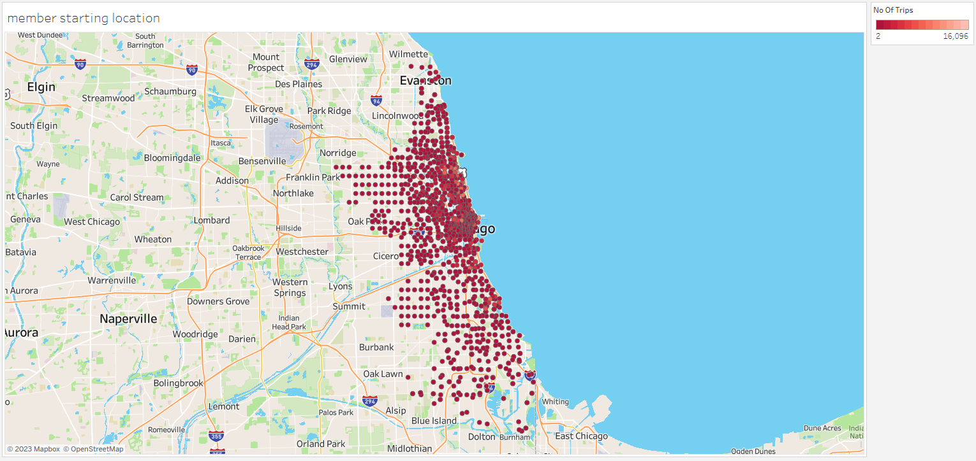
Location distribution for start and end of trip for both casual and member customers
Members start location

Slide 19
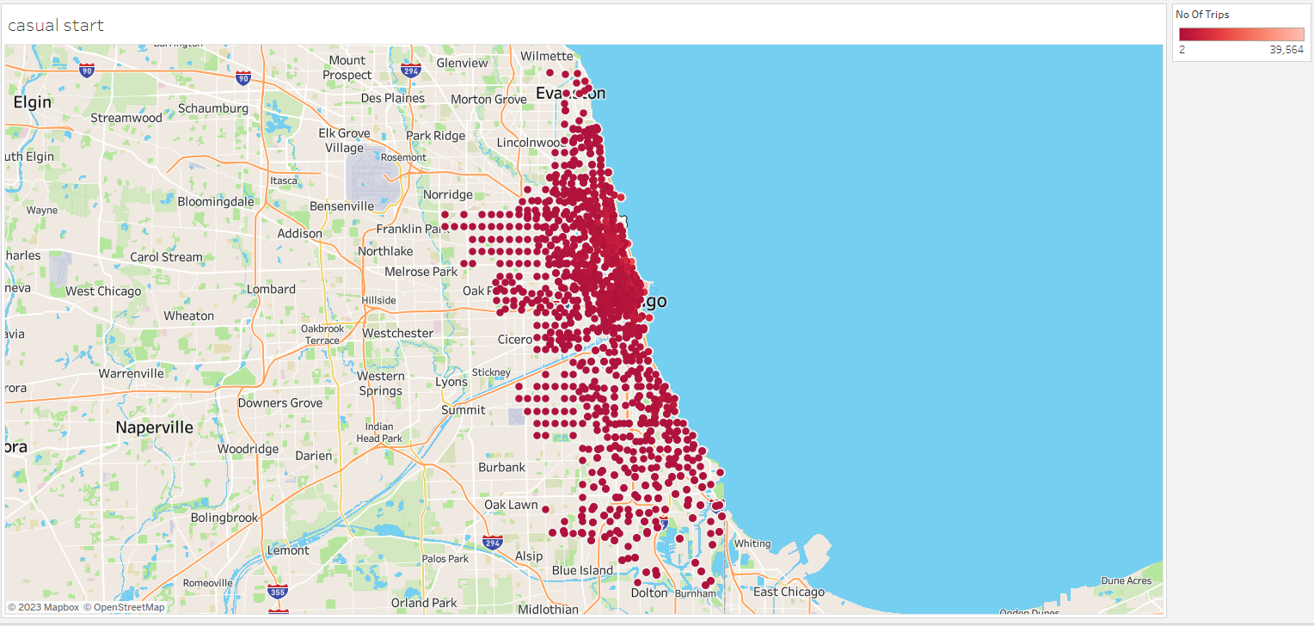
Casual customer start location

Slide 20
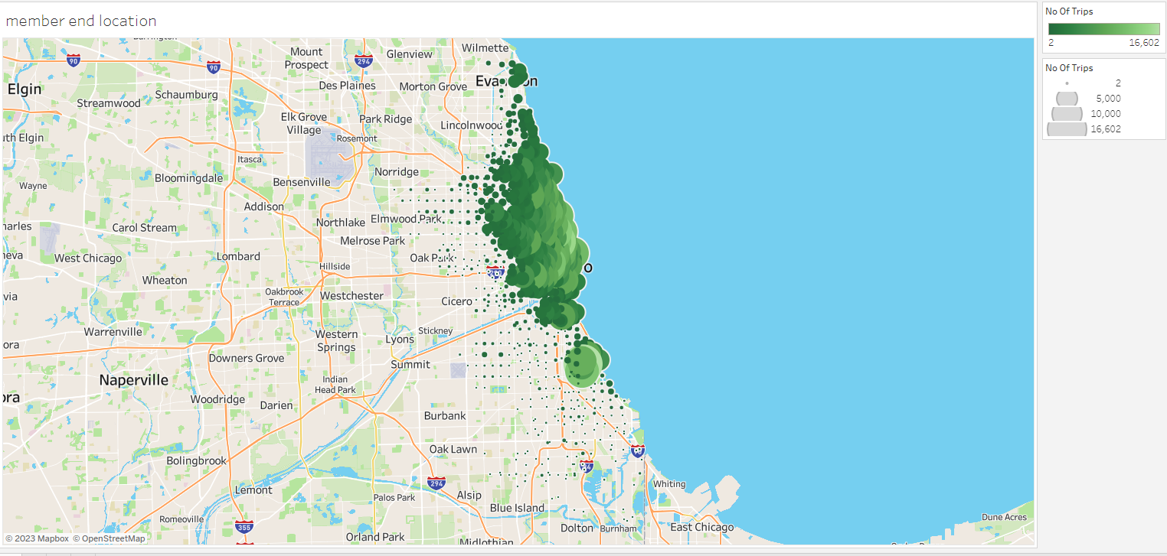
Member trip end location

Slide 21
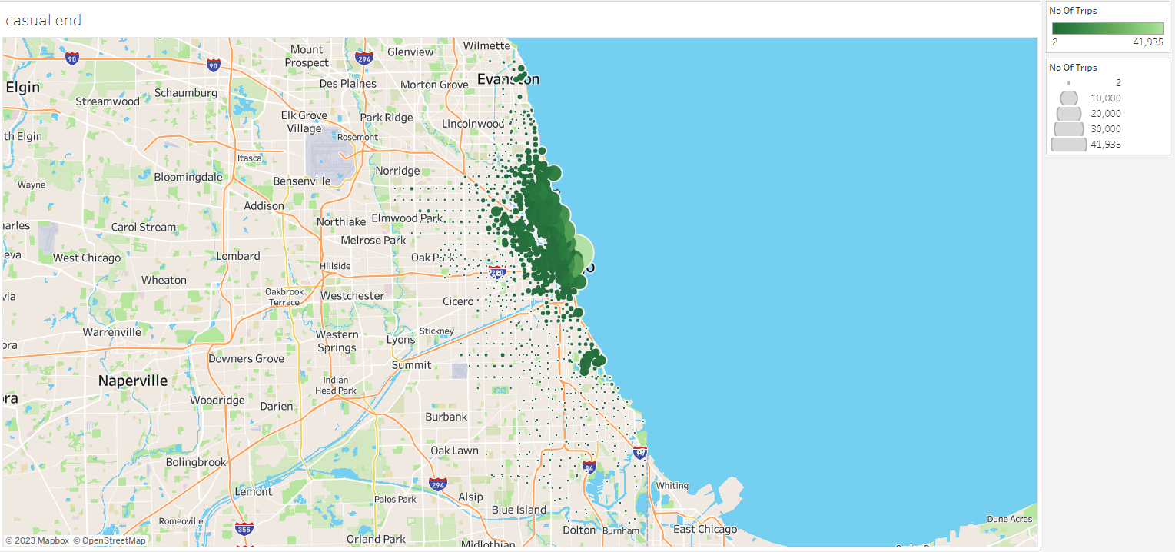
Casual customer trip end location

Slide 22
Major Findings in Customers driving pattern
Member users ride more often than casual riders, except on weekends and during the peak of the summer.
Member users follow predictable paths from and to the city centre, whereas Casual users ride closer to leisure areas and follow less predictable paths.
Casual users ride on average longer than member users, but member users ride length doesn't fluctuate as much during the week.
Some of the rides by casual members were really long close to 22 days .
Streeter Dr & Grand Ave , DuSable Lake Shore Dr & Monroe St , Michigan Ave & Oak St Millennium Park are some of the most common stations where maximum numbers of trips started or ended for casual customers
Classic and Electric bikes were used majorly by both Members and casual customers . Only a few casual customers used docked bike .

Slide 23
Recommendation for marketing to convert casual riders to members
Advertising about the membership program to customers mainly during peak hours of casual customers at the locations like Streeter Dr & Grand Ave , DuSable Lake Shore Dr & Monroe St , Michigan Ave & Oak St ,Millennium Park which are most common start and finish point of trips .
Launching some offers or discount on Yearly membership programs during weekends of summers .
Slightly increasing the price for casual rides and making membership programs more affordable and showing the casual rider benefits of taking membership .

Slide 24
Scope of Further Analysis
Collecting and analyzing other details of riders such as age, gender ,purpose of ride for further understanding the customer and make more data driven decision for marketing .
Make it mandate to collect the starting and end location of each ride .
Conducting surveys to identify why docked bikes aren’t used by riders .

Slide 25
THE END

